Slide 1
Software Quality Assurance and Reviews
Sobia Usman

Slide 2
Peer Reviews
Peer Review Methods
1. Inspections
2. Walkthroughs
Difference between formal design reviews and peer reviews is rooted in their participants and authority.
FDRs: most participants hold superior positions to the project leaders and customer representatives
Peer reviews, the project leader’s equals, members of his or her department and other units.

Slide 3
Peer Reviews
Other major difference lies in
degree of authority and
objective of each review method
FDRs: authorized to approved document
work can now continue in project
This authority is not granted to the peer reviews
whose main objectives lie in
detecting errors and
deviations from standards

Slide 4
Peer Reviews: Inspections / WalkThroughs
Walkthroughs and inspection differ in formality
Inspection the more formal of the two
Inspections emphasize the objective of corrective action
Walkthroughs limited to comments on document reviewed.
Inspections are considered to contribute more to SQA.

Slide 5
Peer Reviews: Inspections
Inspections usually based on a comprehensive infrastructure:
Development of inspection checklists for each type of design document as well as coding languages, which are periodically updated.
Development of typical defect type frequency tables, based on past findings to direct inspectors to potential ‘defect concentration areas.’
Training of competent professionals in inspection process issues – making it possible for them to serve as inspection leaders (moderators) or inspection team members
Periodic analysis of the effectiveness of past inspections to improve the inspection methodology
Scheduled inspections into project activity plan and allocation of the required resources, including resources for corrections

Slide 6
Focus on Peer Reviews:
So for these two peer review methods, we will look at:
Participants of peer reviews
Preparation for peer reviews
The peer review session
Post peer-review activities
Peer review efficiency
The principles that we talk about can apply to both design peer reviews and code peer reviews.

Slide 7
Participants of Peer Reviews
3-5 participants
A recommended peer review team includes:
A review leader
The author
Specialized professionals.

Slide 8
Participants of Peer Reviews
Inspection
Walkthrough
Review leader
The author
Specialized professionals:
Designer
Coder or implementer
Tester
Review leader
The author
Specialized professionals:
Standards enforcer
Maintenance expert
User representative

Slide 9
Participants of Peer Reviews
Review Leader
Moderator in inspections; Coordinator in walkthroughs.
Must be well-versed in project development and current technologies
Have good relationships with author and development team
Come from outside the project team
History of proven experience in coordination / leadership settings like this.
For inspections, training as a moderator is required.

Slide 10
Participants of Peer Reviews
Specialized Professionals
These differ by review type: inspections / walkthroughs
Inspections:
Designer – generally the systems analyst responsible for analysis and design of software system reviewed
coder or implementer – one who is thoroughly acquainted with coding tasks, preferably the leader of the designated coding team.
Able to detect defects leading to coding errors and other software implementation issues.
Tester – experienced professional, preferably leader of assigned testing team.

Slide 11
Participants of Peer Reviews
Specialized Professionals
Walkthroughs:
A standards enforcer – team member specialized in development standards and procedures
locate deviations from these standards and procedures.
A maintenance expert – focus on maintainability / testability issues
to detect design defects that may hinder bug correction and impact performance of future changes
Focuses also on documentation (completeness / correctness) vital for maintenance activity.
A user representation

Slide 12
Participants of Peer Reviews: Team Assignments
Presenter:
For inspections:
The presenter of document; chosen by the moderator; should not be document’s author
Sometimes the software coder serves as presenter due to the familiarity of the design logic and its implications for coding.
For walkthroughs:
Author most familiar with the document should be chosen to present it to the group.
Could be design document developer; programmer for code
Some argue that a neutral person should be used..
Scribe: Team leader will often serve as the scribe and record noted defects to be corrected.

Slide 13
Preparation for a Peer Review Session
Peer Review Leader’s Preparation for the session:
To determine, together with the author, which sections of the document are to be reviewed. Such sections can be:
– The most difficult and complex sections
– The most critical sections, where any defect can cause severe damage to the program application and thus to the user
To select the team members.
To schedule the peer review sessions.
Distribute the document to the team members prior to the review session

Slide 14
Preparation for a Peer Review Session
Peer review team member’s preparations for review session:
For inspections: team members, preparation is quite thorough
Inspection: participants must read document and list comments before inspection begins.
In overview meeting, the author provides inspection team members with the necessary background for reviewing chosen document, project in general, logic, processes, outputs, inputs, interfaces.
Tool for inspector’s review: checklist for specific documents.

Slide 15
Preparation for a Peer Review Session
For walkthroughs: team briefly reads materials for general overview of project
Generally they lack detailed knowledge
In most cases, team participants not required to prepare advance comments.

Slide 16
The Peer Review Session
In inspection
presenter reads document section and may add an explanation.
Participants may offer comments
Restrict discussion to identification of errors.
Presenter in walkthrough provides an overview
Walkthrough Scribe records each error (location, description, type and character (incorrect, missing parts, extra parts etc).
Inspection scribe will add estimated severity of each defect and the formulation of preventive / corrective actions.

Slide 17
The Peer Review Session
Session Documentation
For inspections – much more comprehensive
Two documents are to be produced following an inspection session and distributed among the session participants:
Inspection Session Findings Report – produced by scribe
full documentation of identified errors for correction and follow up.

Slide 18
The Peer Review Session
Inspection Session Summary Report
This report is to be compiled by the inspection leader shortly after the session or series of sessions dealing with the same document.
A typical report of this type summarizes the inspection findings and the resources invested in the inspection
For walkthroughs – copies of the error documentation should be provided to the development team and the session participants

Slide 19
Post-peer Review activities
Inspection:
Post inspection activities are conducted to attest to:
Effective correction / reworking of all errors
Transmission of the inspection reports to the internal Corrective Action Board (CAB) for analysis.

Slide 20
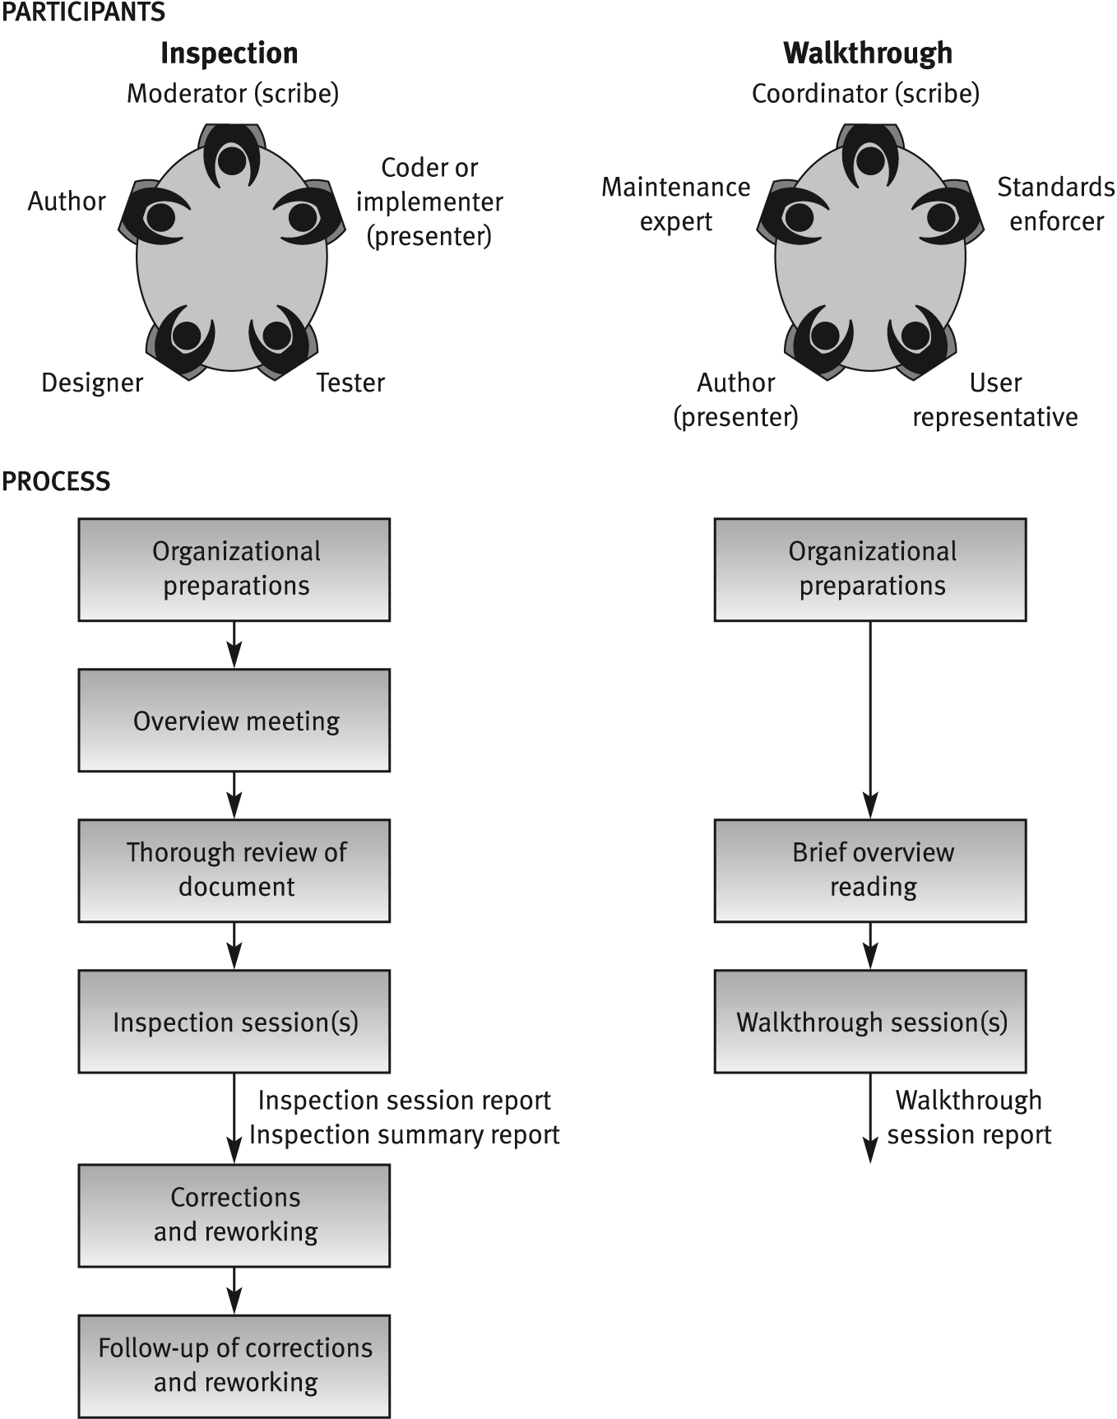
Inspection vs. Walkthrough

Slide 21
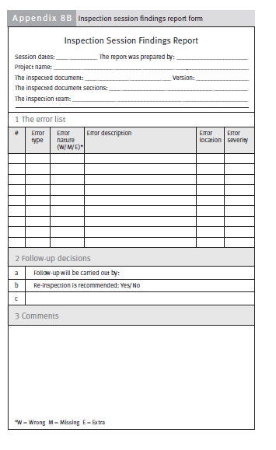

Slide 22
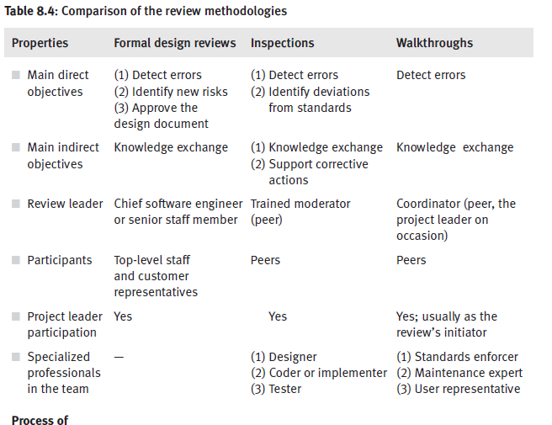
Comparison of review methodologies

Slide 23
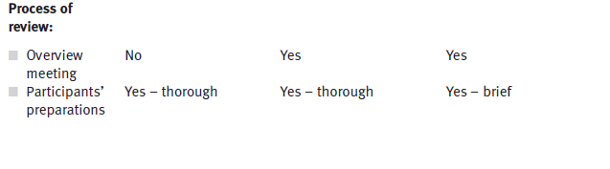
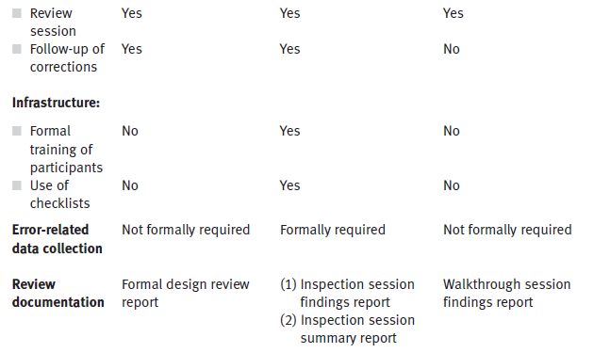
Comparison of review methodologies

Slide 24
Expert Opinions
Expert opinions support quality assessment efforts by introducing additional external capabilities into the organization's in-house development process
Turning to outside experts may be particularly useful in the following situations:
– Insufficient in-house professional capabilities in a given area
– In small organizations: difficult to find enough suitable candidates to participate in the design review teams
– In small organizations: extreme work pressures, an outside expert’s opinion can replace an inspection process
– Temporary inaccessibility of in-house professional
– In cases of major disagreement among the organization's senior professional, an outside expert may support a decision

Slide 25
Exercise
Consider the following tables (Table1 and Table 2), and prepare “Inspection Session Summary Report’’ of design document consisting of 31 pages.
Total (hours) and total errors (standardized)
Average defects per page(Total Errors/Total Pages=C/A)
Average defects per page (standardized)(D/A )
Defects detection efficiency (hours per defect= B/C )
Standardized defect detection efficiency(B/D )

Slide 26
Table 1: Resources Invested (Hours)
# | Team member | Overview meeting | Preparation | Inspection session | Total (hours) | Comments
1 | Inspection leader Anita | 1 | 3 | 2.5 |  | Including report preparation
2 | John | 1 | 4 | 2
3 | Ben | 1 | 4 | 2

Slide 27
Table 2: Error summary
Error severity | Error nature Wrong Missing Extra |  |  | Total errors | Severity factor | Total errors (standardized)
5-critical | 1 |  |  |  | 16
4 |  |  | 2 |  | 8
3 | 3 |  |  |  | 4
2 |  | 2 |  |  | 2
1-minor | 4 | 1 | 2 |  | 1

Slide 28
Solution
Resources invested (hours worked)
# | Team member | Overview meeting | Preparation | Inspection session | Total (hours) | Comments
1 | Inspection leader Anita | 1 | 3 | 2.5 | 6.5 | including report preparation
2 | John | 1 | 4 | 2 | 7
3 | Ben | 1 | 4 | 2 | 7
 | Total | 3 | 11 | 6.5 | (B)20.5
Error summary
Error severity | Error nature W M E* |  |  | Total errors | Severity factor | Total errors (standardized) | Comments
5-critical | 1 |  |  | 1 | 16 | 16
4 |  |  | 2 | 2 | 8 | 16
3 | 3 |  |  | 3 | 4 | 12
2 |  | 2 |  | 2 | 2 | 4
1-minor | 4 | 1 | 2 | 7 | 1 | 7
Total | 8 | 3 | 4 | (C)15 |  | (D)55

Slide 29
Solution
Total hours= 20.5, Total errors (standardized) = 55
Average defects per page = Total Errors/Total Pages = C/A = 15/31= 0.48
Average defects per page (standardized) = D/A = 55/31= 1.71
Defects detection efficiency (hours per defect) = B/C = 20.5/15= 1.37
Standardized defect detection efficiency (hours per standardized defect) = B/D =20.5/55= 0.37

Slide 30
References
Chapter 8, Reviews, Software Quality Assurance from theory to implementation by Daniel Galin

